Slide 1
DPU Electric Grid Modernization Working Group
Fred Avila
AvCom, Inc.
January 9, 2013
Notes:
This template can be used as a starter file to give updates for project milestones.
Sections
Right-click on a slide to add sections. Sections can help to organize your slides or facilitate collaboration between multiple authors.
Notes
Use the Notes section for delivery notes or to provide additional details for the audience. View these notes in Presentation View during your presentation.
Keep in mind the font size (important for accessibility, visibility, videotaping, and online production)
Coordinated colors
Pay particular attention to the graphs, charts, and text boxes.
Consider that attendees will print in black and white or grayscale. Run a test print to make sure your colors work when printed in pure black and white and grayscale.
Graphics, tables, and graphs
Keep it simple: If possible, use consistent, non-distracting styles and colors.
Label all graphs and tables.

Slide 2
AvCom, Inc.
Incorporated in 1996
Located in Scituate, MA
Manufacturers’ representative and distributor
Specialize in measurement and automation products for the electric, gas and water utilities in New England and New York
Sold three AMI systems in the past year. One OpenWay, and two ChoiceConnect

Slide 3
What is Automatic Meter Reading (AMR)?
Designed as a cost effective way to accurately read meters
Can be implemented gradually with immediate cost savings during installation process
Payback usually 24 to 36 months
Reduced reading costs
Better accuracy
Customer information
Notes:
* If any of these issues caused a schedule delay or need to be discussed further, include details in next slide.

Slide 4
What is Advanced Metering Infrastructure (AMI)?
Fixed Network Infrastructure (2 way communication between meter and utility)
Outage reporting
Remote Shut-off and Turn-on
Appliance control
Interval data information available for every customer
Flexible TOU (TOU)
Real Time Pricing (RTP)
Critical Peak Pricing (CPP)
Other
Notes:
Duplicate this slide as necessary if there is more than one issue.
This and related slides can be moved to the appendix or hidden if necessary.

Slide 5
Positive and Negative Affects of AMR
+ Cost effective
+ Efficient
+ Accurate
+ Non intrusive
+ Easily implemented
- Inflexible rate structures
- No on demand reads
- No interval data
- No outage management

Slide 6
Positive and Negative Affects of AMI
+ Interval data for flexible rates
+ On demand reads
+ Accurate
+ Remote turn on/shut off
+ Customer interaction
- High cost
- High maintenance
- Customer resistance
- Overwhelming data
- Not easily justified

Slide 7
Do Flexible Rate Structures (TOU, RTP, CPP) Actually Save Substantial Amounts of Electricity and/or Costs?
Limited buy-in ^{1, 2, 3}
High drop out ^{1, 3}
Little consumer savings ^{1, 2}
Small kWh savings ^{1, 2, 3, 4}

Slide 8
Is Hybrid Drive-by or AMR Fixed Network a Realistic Alternative? (Software/HAN or ChoiceConnect)
Allows customer interaction
Allows appliance control
Interval data for flexible pricing (TOU, RTP, CPP, etc.)
On demand reads
Realistic additional cost

Slide 9
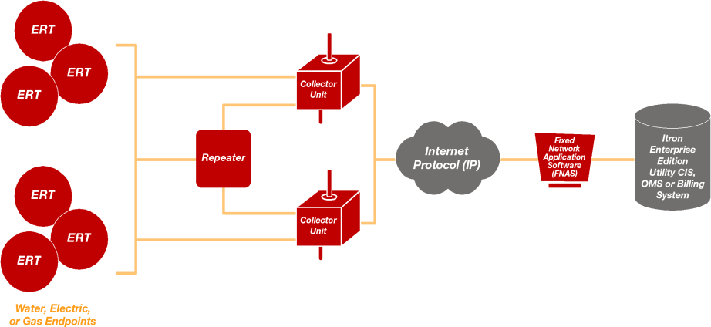
ChoiceConnect Fixed Network

Slide 10
Is AMI Cost Justifiable?
TOU has no significant effect on peak demand ^{1, 2}
Reported savings are small and questionable ¹
High drop out rate (at least 1% per month) ^{1, 3}
Self selection bias in existing studies ¹
Significant part of cost justification includes remote shut offs (SCE)
Savings to C&I customers less than residential ¹
Largest use of electricity was for appliances not easily automatically controlled or load shifted ⁴

Slide 11
Looking Ahead
Energy efficient appliances ⁴
Residential electricity use to rise only .7% per year through 2040 ⁵
Industrial electricity use to rise only .6% per year through 2040 ⁵

Slide 12
Bibliography
¹ Results of CL&P Plan–It Wise Energy Pilot
Docket No. 05-10-03RE01, Compliance order No. 4
^{2 “}The Effect of Utility Time-Varying Pricing and Load Control Strategies on Residential Summer Peak Electricity Use: A Review,” National Research Council Canada
³ “Why Time Ran Out on PSE’s Time of Use Program,” Powergrid International
Notes:
Prepare slides for the appendix in the event that more details or supplemental slides are needed. The appendix is also useful if the presentation is distributed later.

Slide 13
Bibliography Continued
⁴ “End-Use Consumption of Electricity 2001,” Energy Information Agency, Department of Energy.
⁵“U.S. Electricity Use on Wane” Wall Street Journal January 3, 2013
Notes:
Prepare slides for the appendix in the event that more details or supplemental slides are needed. The appendix is also useful if the presentation is distributed later.

